Slide 1

Addressing Nocturia in Primary Care
Marco Blanker, MD PhD
Academic GP & epidemiologist
1

Slide 2
declaration of interests
member ICUD subcommittee on nocturia
member of ICS/ICCS working group on nocturia
author of Dutch GP-guideline Male LUTS
2012 New England Research Institute Meeting on nocturia (supported by Ferring)
no financial ties whatsoever

Slide 3
Your input is more than welcome in this presentation
so feel free to interrupt,
ask questions, or even correct me

Slide 4
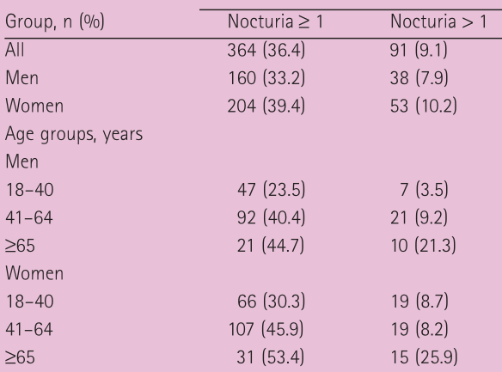
Nocturia in the general population
Nocturia (awakening to void during sleeping time) is very common in the general population
e.g. Canadian
Urinary Bladder
Survey (1,000
males & females)
(BJUI 2008;101(1):52-8)
Notes:
toevoegen cijfers prevalentie en incidentie mannen en vrouwen

Slide 5
Nocturia in the general population
e.g. Krimpen Study
(1,688 Dutch males)
(J Urol 2000;164(4):1201-5)
Notes:
toevoegen cijfers prevalentie en incidentie mannen en vrouwen

Slide 6
Nocturia in primary care
Nocturia (awakening to void during sleeping time) is very common in the general population
but is it common in general practice as well?
Notes:
toevoegen cijfers prevalentie en incidentie mannen en vrouwen

Slide 7
Nocturia in primary care
How often do you ask your patients if they have nocturia?
(raise hands)
each month
each week
every day

Slide 8
Nocturia in primary care
Please rise if you can recall a patient who has consulted you for the complaint of nocturia in the previous
week
fortnight
month
year

Slide 9
Nocturia in primary care
How did you address these patients?
Which guideline was available?
What’s the evidence base of these guidelines?
Who wrote these guidelines?
In the absence of proper primary care research on nocturia, guidelines are based on secondary/tertiary care info
– and written by medical specialists….

Slide 10
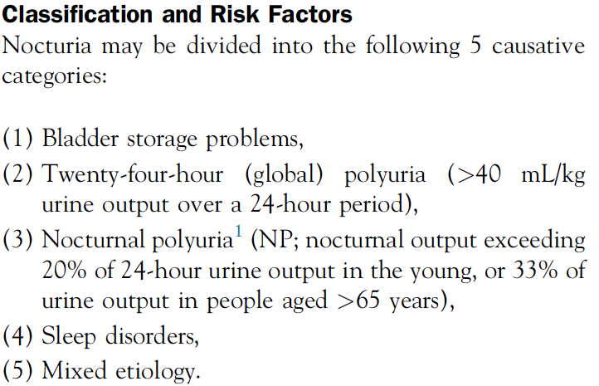
Nocturia guidelines - ICUD
Normal pattern with ageing??

Slide 11
Nocturia guidelines - ICUD
Bladder storage problems
24-hour polyuria
both coincide with daytime LUTS
sleep disorders, especially OSAS
daytime fatigue
nocturnal polyuria
what is it?

Slide 12
Nocturnal polyuria
Current ICS definition
Nocturnal urine production (UP) > 20-33% of 24-hour UP
This definition has no discriminative value for the presence of nocturia

Slide 13
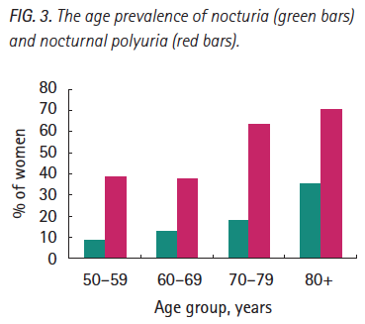
Nocturnal polyuria
Current ICS definition
Nocturnal urine production (UP) > 20-33% of 24-hour UP
Swithinbank et al.
(227 community-dwelling women)
(BJUI 2004;93(4):523-7)

Slide 14
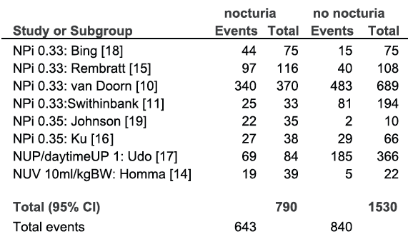
Nocturnal polyuria
Current ICS definition
Nocturnal urine production (UP) > 20-33% of 24-hour UP
Hofmeester et al.
(meta-analyses)
(J Urol 2014;191:1028-33)
81% - 55%

Slide 15
Nocturnal polyuria
Current ICS definition
Nocturnal urine production (UP) > 20-33% of 24-hour UP
Based on daytime/night-time ratio
Should be based on nocturnal urine production alone
ICS currently reconsiders this definition

Slide 16
Nocturnal polyuria
Long list of diseases associated to nocturnal polyuria
(and consequently nocturia)
Congestive heart failure
Diabetes mellitus
Obstructive sleep apnea
Peripheral edema
Excessive nighttime fluid intake
Idiopathic (“primary”)
Patients
will
present
with
other symptoms!!

Slide 17
Nocturia – a symptom among other LUTS
In primary care, nocturia most often is seen along with other LUTS
Nocturia is considered as one of the most bothersome LUTS
So, what to do?

Slide 18
Nocturia – a symptom among other LUTS
In males: beware of “prostate-fear”, both prostate cancer and enlarged prostates as the cause of symptoms
In females & males: use frequency volume chart (FVC)
How often do you use FVC’s in your practice?
What is your “skills-level”?

Slide 19
Frequency volume charts
How many days?
Volume intake?
Which form?
preferrably 3
ICS: yes
Which ever you prefer
MB: no
Elaborate for patients to record volume intake.
“What goes out must have gone in.”

Slide 20
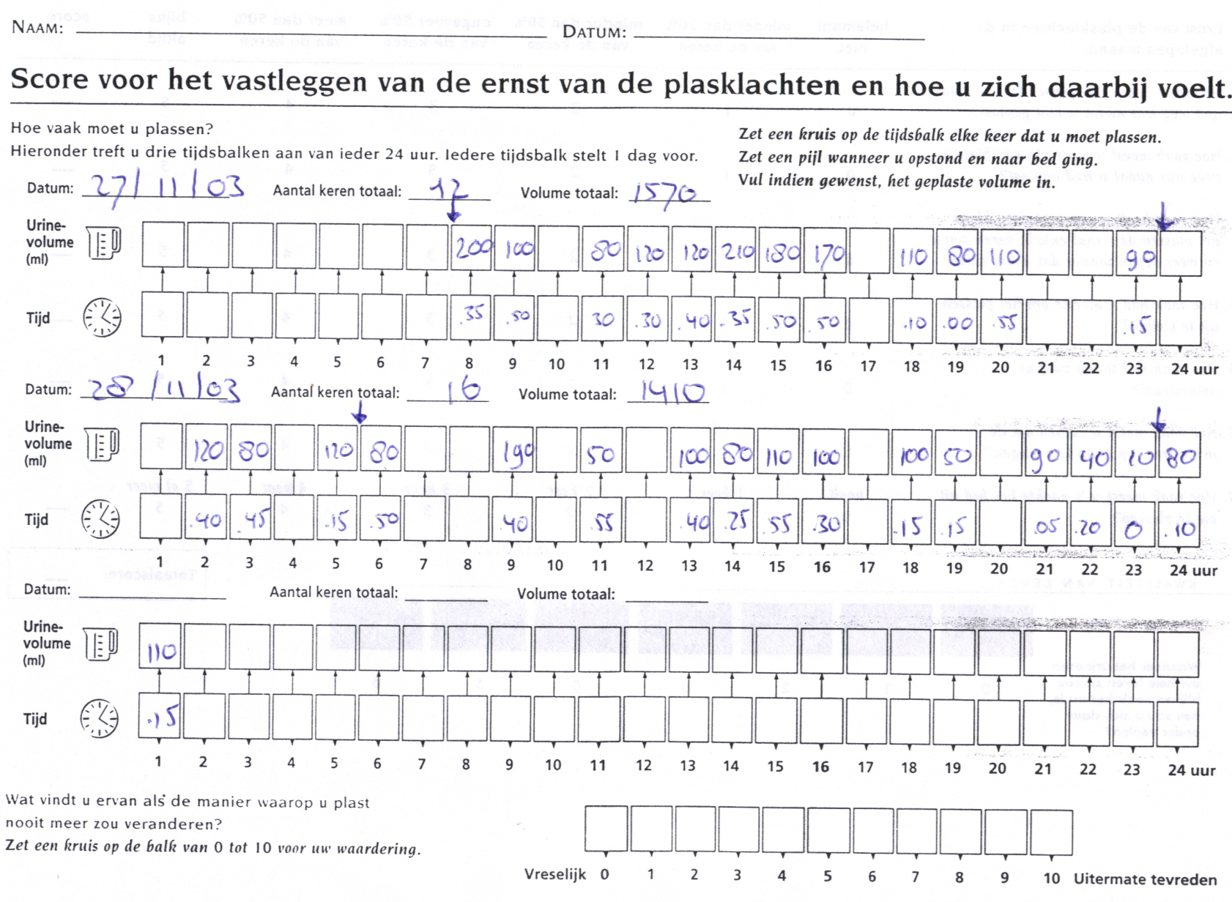
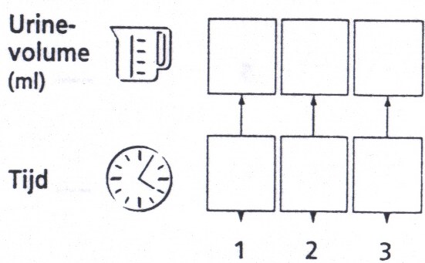
Frequency volume charts

Slide 21
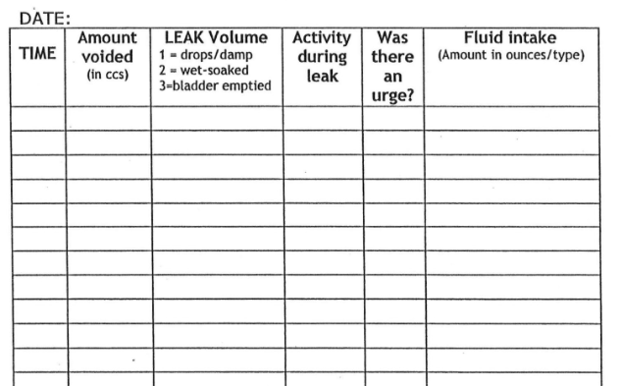
Frequency volume charts

Slide 22
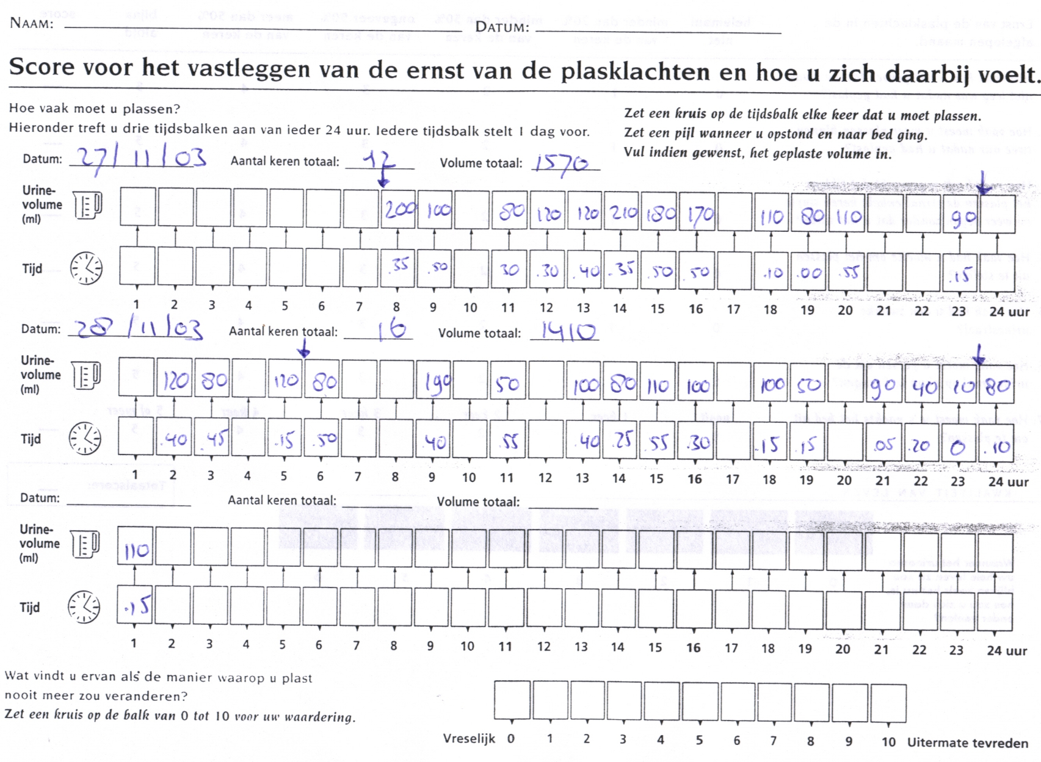
Frequency volume charts
Compare to reference values
1200-2000 ml
age dependent
Retreive from FVC
24 hr volume
nocturnal voiding frequency
nocturnal urine production
(this includes 1st morning void)
maximum voided volume
(functional bladder capacity)
mean voided volume

Slide 23
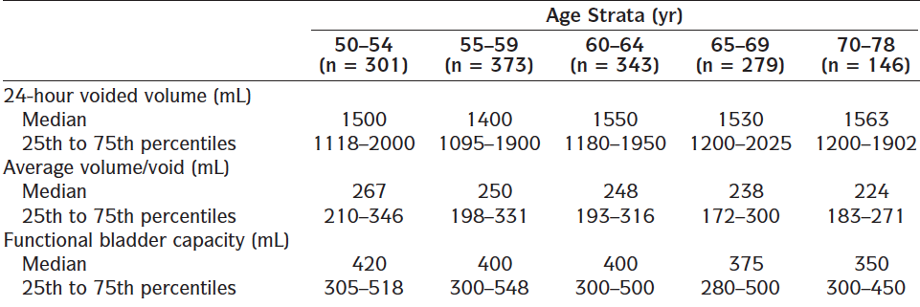
Frequency volume charts
Urology 2001;57:1093-9

Slide 24
Frequency volume charts
Compare to reference values
1200-2000 ml
age dependent
Retreive from FVC
24 hr volume
nocturnal voiding frequency
nocturnal urine production
(this includes 1st morning void)
maximum voided volume
(functional bladder capacity)
mean voided volume
Often: reassurance based on figures from FVC

Slide 25
Nocturia treatment (ICUD recommendations)
No studies performed in primary care
Clinically meaningful outcome?
Step 1: lifestyle / behavioural modification (LOE 3 / GOR C)
Step 2: Pharmacotherapy
alpha-blockers (LOE 1 / GOR A): only modest effect!
no 5-alpha reductase inhibitors
combination therapy
anti-muscarinic agents (OAB-related nocturia) (LOE 1/GOR A)
diuretics / antidiuretics

Slide 26
Nocturia treatment (ICUD recommendations)
No studies performed in primary care
Clinically meaningful outcome?
antidiuretics (desmopressin)
LOE 1 / GOR A
Still only modest effect: 0.7 voidings/night less than placebo
(meta-analyses J Urol. 2014;192:829-835)
most studies used a dose titration phase (source of bias!)
most studies included healthy patients only
BEWARE of hyponatremia (check before & during treatment)

Slide 27
Nocturia treatment (ICUD recommendations)
No studies performed in primary care
Clinically meaningful outcome?
diuretics (furosemide)
LOE 2 / GOR B
6 hours before sleep

Slide 28
Nocturia in primary care
Nocturia (awakening to void during sleeping time) is very common in the general population, but in general practice
nocturia is not frequently encountered as a reason for consultation in general practice,
but mainly seen as a symptom alongside with other problems.
FV-charts are the cornerstone of the assessment of nocturia
Notes:
toevoegen cijfers prevalentie en incidentie mannen en vrouwen

Slide 29

Addressing Nocturia in Primary Care
Marco Blanker, MD PhD
Academic GP & epidemiologist
@marco_blanker
Thank you for your attention!
29

Slide 30
Coffee Break/Exhibition Viewing

Slide 31

BAUN & links with Primary Care
Fiona Sexton, RN, BSc, SPQ, MSc
Urology Specialist Nurse
President BAUN

Slide 32
BAUN & links with Primary Care
What BAUN does
The role of the Urology CNS
How can we work with Primary Care?

Slide 33
What do we do in BAUN?
Education
Study days
Conference
Networking/Collaboration/communication
Guidelines & Quality standards
Audit
Research
Advice
Political monitoring
Working with
  Professional Associations (BAUS, RCN)
  Industry
  Charities
  DoH
  NICE

Slide 34
Role of the Urology CNS
20+ years
Initially continence assessment, catheter changes and ED
Progressed to prostate assessment and haematuria assessment then Flexible cystoscopy & TRUS biopsy
Now as diverse as the specialty:
5 organs,
  benign and malignant,
  Surgery & Oncology,
  assessment, pre, during and post treatment until
  discharge or into palliative care.

Slide 35
Potential role development in the community
One stop assessment
  Haematuria, prostate assessment, testicular lumps
  Flexible cystoscopy, TRUS Bx, ultrasound KUB, flow rate
Prostate cancer follow up
Erectile Dysfunction
Keeping people out of hospital?

Slide 36
Primary Care Urology Society
2nd Annual Meeting
3 November 2015
London
Chair
Dr Jon Rees
Backwell & Nailsea Medical Group, Bristol
www.primarycareurologysociety.org

